Slide 1
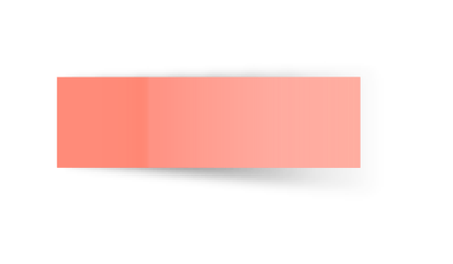
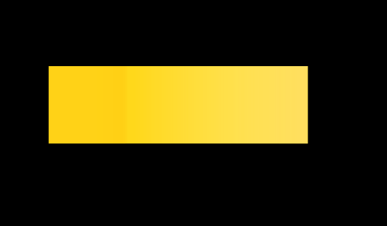
NOTEBOOK LESSON
Here starts the lesson!

Slide 2
Contents of this template
Here’s what you’ll find in this Slidesgo template:
A slide structure based on a lesson presentation, which you can easily adapt to your needs. For more info on how to edit the template, please visit Slidesgo School or read our FAQs.
An assortment of illustrations to use in the presentation can be found in the alternative resources slide.
A thanks slide, which you must keep so that proper credits for our design are given.
A resources slide, where you’ll find links to all the elements used in the template.
Instructions for use.
Final slides with:
The fonts and colors used in the template.
A selection of illustrations. You can also customize and animate them as you wish with the online editor. Visit Storyset to find more.
More infographic resources, whose size and color can be edited.
Sets of customizable icons of the following themes: general, business, avatar, creative process, education, help & support, medical, nature, performing arts, SEO & marketing, and teamwork.
You can delete this slide when you’re done editing the presentation.

Slide 3

Table of Contents!
Overview
Assignment
Topic features
About the topic
Describe the topic of the section here
Describe the topic of the section here
Describe the topic of the section here
Describe the topic of the section here

Slide 4

01
OVERVIEW
You can enter a subtitle here if you need it

Slide 5



Introduction
Neptune is the farthest planet from the Sun and also the fourth-largest by diameter in the entire Solar System

Slide 6
Introduction
You can give a brief description of the topic you want to talk about here. For example, if you want to talk about Mercury, you can say that it’s the smallest planet in the entire Solar System

Slide 7

—Someone Famous
Book Title. P52
“This is a quote. Words full of wisdom that someone important said and can make the reader get inspired.”

Slide 8
Definition of concepts
Mercury
Mars
Saturn
Venus
Mercury is the smallest planet
Despite being red, Mars is a cold place
It’s composed of hydrogen and helium
Venus is the second planet from the Sun

Slide 9
Concepts we should not forget
Venus
Jupiter
Mars
Saturn
Venus is the second planet from the Sun
It’s the biggest planet in the Solar System
Despite being red, Mars is a cold place
Saturn is a gas giant and has several rings

Slide 10
Features of the topic
Mercury
Jupiter
Mars
It’s the closest planet to the Sun
Jupiter is the biggest planet
Venus is the second planet from the Sun
Mars is actually a cold place

Slide 11
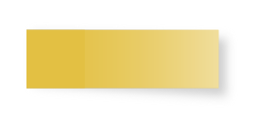
Main characteristics
Venus
Mars
Mercury
Venus has a beautiful name and it is very hot
Mars is actually a cold place, despite its red color
It’s the closest planet to the Sun and the smallest one

Slide 12

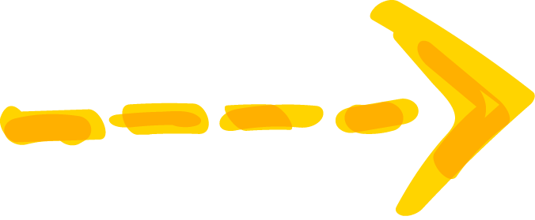
Some important numbers
2,569
1,458
4,759
Mercury is the closest planet to the Sun
Jupiter is the biggest planet of them all
Neptune is the farthest planet from the Sun

Slide 13
10%
50%
40%
Despite being red, Mars is a cold place
Saturn is the only planet
with rings
Venus has a beautiful name, but it’s hot

Slide 14

Practical uses of this subject
Mercury
Jupiter
Mercury is the closest planet to the Sun
Venus is the second planet from the Sun
Jupiter is the biggest planet of them all

Slide 15
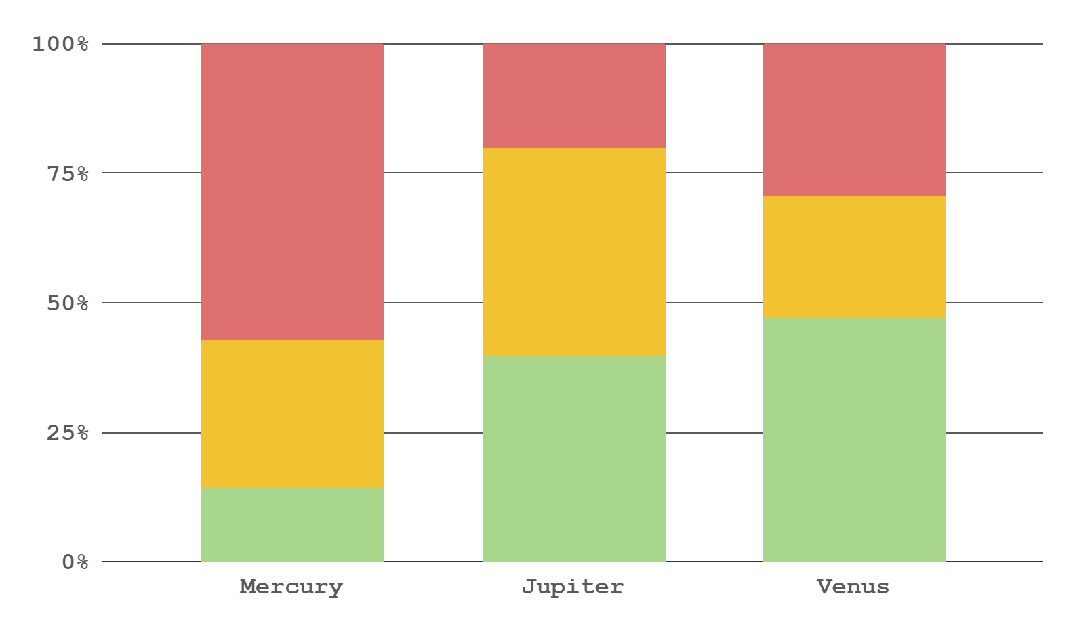
Did you know this?
35%
65%
To modify this graph, click on it, follow the link, change the data and replace this
Mercury is a small planet
Jupiter is the biggest one
Factor 1
Factor 2
Factor 3

Slide 16


Process
Step 1
Step 2
Step 3
Step 4
Mercury is the smallest planet
Saturn is the ringed planet
Venus has a beautiful name
Mars is a very cold place

Slide 17

The learning process
1
Mercury is the smallest planet
4
Saturn is the ringed planet
2
Venus has a beautiful name
5
Jupiter is the biggest planet
3
Mars is a very cold place
6
Neptune is far from the Sun

Slide 18
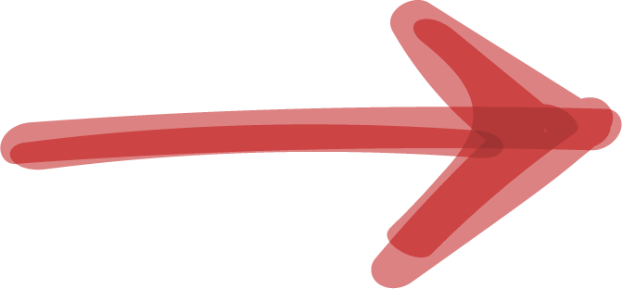

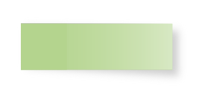
Relations between concepts
Mercury is a small planet
Mars is a cold place
Jupiter is a gas giant
Venus is a hot planet
Only Saturn has rings

Slide 19

Exams and
retakes calendar
April 2022
Saturn
 |  |  |  | 1 | 2 | 3
4 | 5 | 6 | 7 | 8 | 9 | 10
11 | 12 | 13 | 14 | 15 | 16 | 17
18 | 19 | 20 | 21 | 22 | 23 | 24
25 | 26 | 27 | 28 | 29 | 30
Saturn is a gas giant with rings
Neptune
Neptune is far from the Sun

Slide 20
Main concepts to know
Mercury
Venus
Saturn
Mercury is the smallest planet
Venus has a beautiful name
Only Saturn
has rings
Mars
Neptune
Mars is a very cold place
Neptune is far from the Sun

Slide 21
Exam’s grades
Grades
Student | Q1 | Q2
Last name, name | A+ | F
Last name, name | A | B
Last name, name | C | A
Last name, name | F | A+
Grades
Student | Q1 | Q2
Last name, name | C | A+
Last name, name | A+ | F
Last name, name | A | B
Last name, name | B | C

Slide 22
This is a gantt chart
 | Week 1 | Week 2 | Week 3
Activity 1
Activity 2
Activity 3
Activity 4
Activity 5

Slide 23
Homework checklist
Saturn
Saturn is the ringed planet
Mercury
Jupiter
Mercury is the smallest planet
It’s a giant and the biggest one
Venus
Neptune
Venus has a beautiful name
Neptune is the
farthest planet
Mars
Earth
Mars is a very cold place
Earth is the planet with life

Slide 24



Learn the difference
First concept
Second concept
Despite being red, Mars is actually a cold place. It’s full of iron oxide dust
Venus has a very beautiful name and is the second planet from the Sun

Slide 25
Classes timetable
 | Mon | Tue | Wed | Thu | Fri
7-8 am | Physics | English | Arts | Physics | Maths
8-9 am | Maths | Arts | Maths | Arts | English
9-10 am | English | Physics | English | Physics | Arts
10-11am | Arts | Maths | Physics | English | Physics

Slide 26
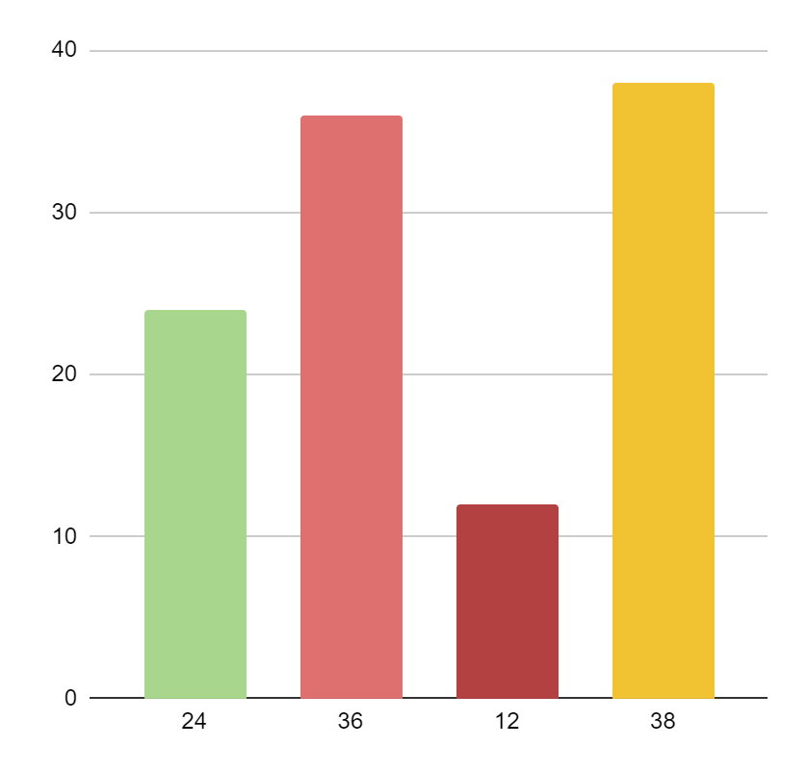
Let’s have a look at this graphic
Mercury
Saturn
It is the smallest planet
Saturn is the ringed planet
Venus
Mars
Venus has a beautiful name
Mars is a very cold place
Follow the link in the graph to modify its data and then paste the new one here. For more info, click here

Slide 27


Awesome words

Slide 28
You can use this diagram
Mercury
Saturn
It is the smallest planet
Saturn is the ringed planet
The Solar System
Venus
Neptune
Venus has a beautiful name
Neptune is far from the Sun
Mars
Jupiter
Mars is a very cold place
Jupiter is the biggest planet

Slide 29
Some percentages
50%
60%
90%
40%
70%
80%
Pluto
Saturn
Venus
Mars
Jupiter
Earth

Slide 30

This infographic might help
1
Mercury is the
Smallest planet
Mercury
2
It’s a giant and the biggest one
Jupiter
3
Mars is actually a cold place
Mars
4
Neptune is far from the Sun
Neptune

Slide 31
Some geography of your country
Mercury
Mercury is the
Smallest planet
Jupiter
Jupiter is the biggest planet
Mars
Mars is actually a cold place

Slide 32
Review of concepts
Mercury
Venus
Mars
Jupiter
Saturn
Neptune
Mercury is the
Smallest planet
Venus has a
beautiful name
Mars is actually a cold place
Jupiter is the biggest planet
Saturn is a gas giant with rings
Neptune is far from the Sun

Slide 33
Revise concepts
Jupiter
Venus
Saturn
Mars
Neptune
Mercury
Jupiter is the biggest planet
Venus has a
beautiful name
Saturn is the
ringed one
Mars is actually a cold place
Neptune is the
farthest planet
Mercury is the
Smallest planet

Slide 34
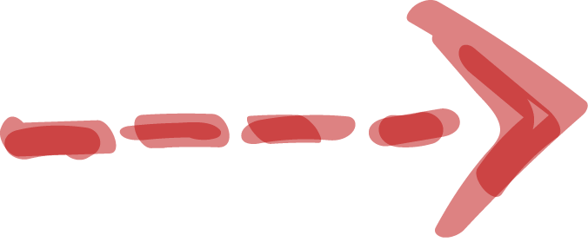
Exercise
Venus has a beautiful name and is the second planet from the Sun
Despite being red, Mars is actually a cold place

Slide 35
Assignment
Which planet has a beautiful name and is the second one from the Sun

Slide 36
Thanks!
Do you have any questions? youremail@freepik.com +91 620 421 838 yourcompany.com
Please keep this slide for attribution.

